Slide 1
TRAINING FREE, ONE SHOT DETECTION
Team: Marvin (Siddhant Katyan)
2018801005, IIIT HYDERABAD

Slide 2

E Take a look at this:

Slide 3
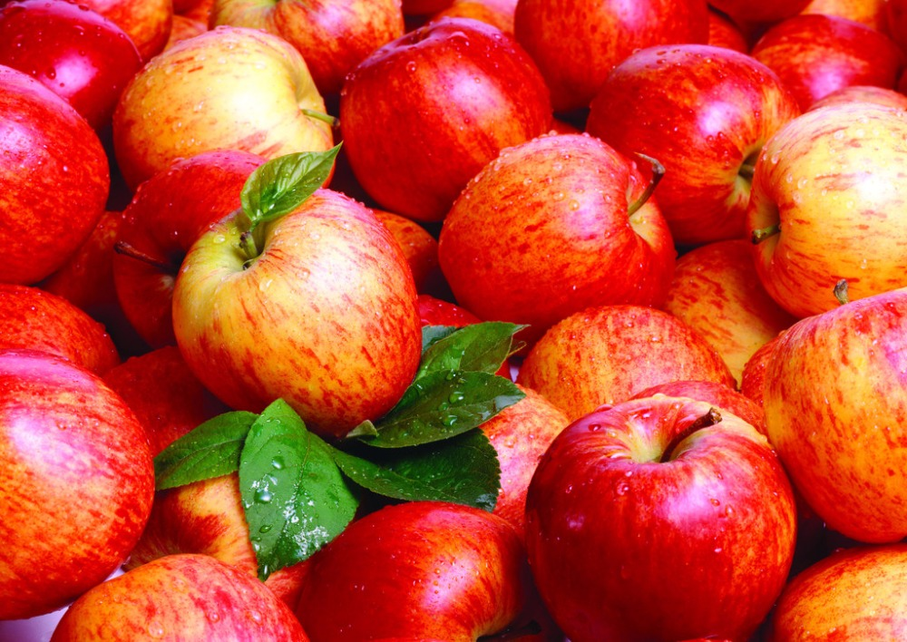
See it here?

Slide 4
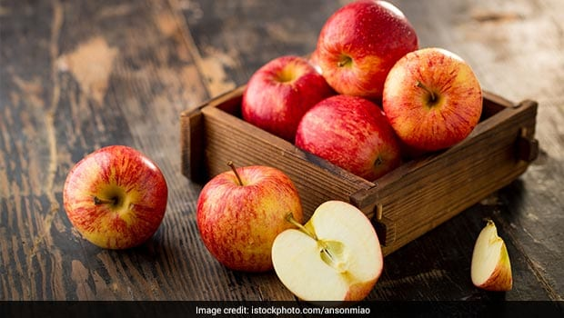
How about here?

Slide 5
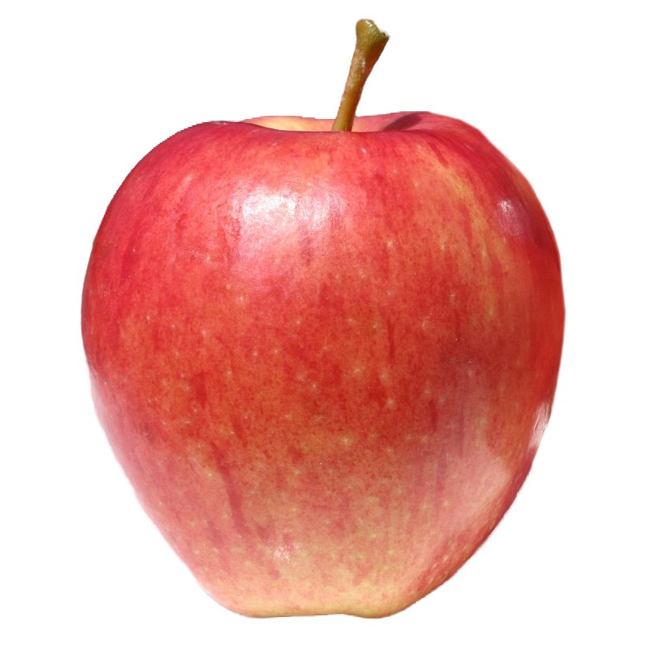
Single Example, No Training!
(Most) people can find the apple from one look.
Even if they’ve never seen it before.

Slide 6

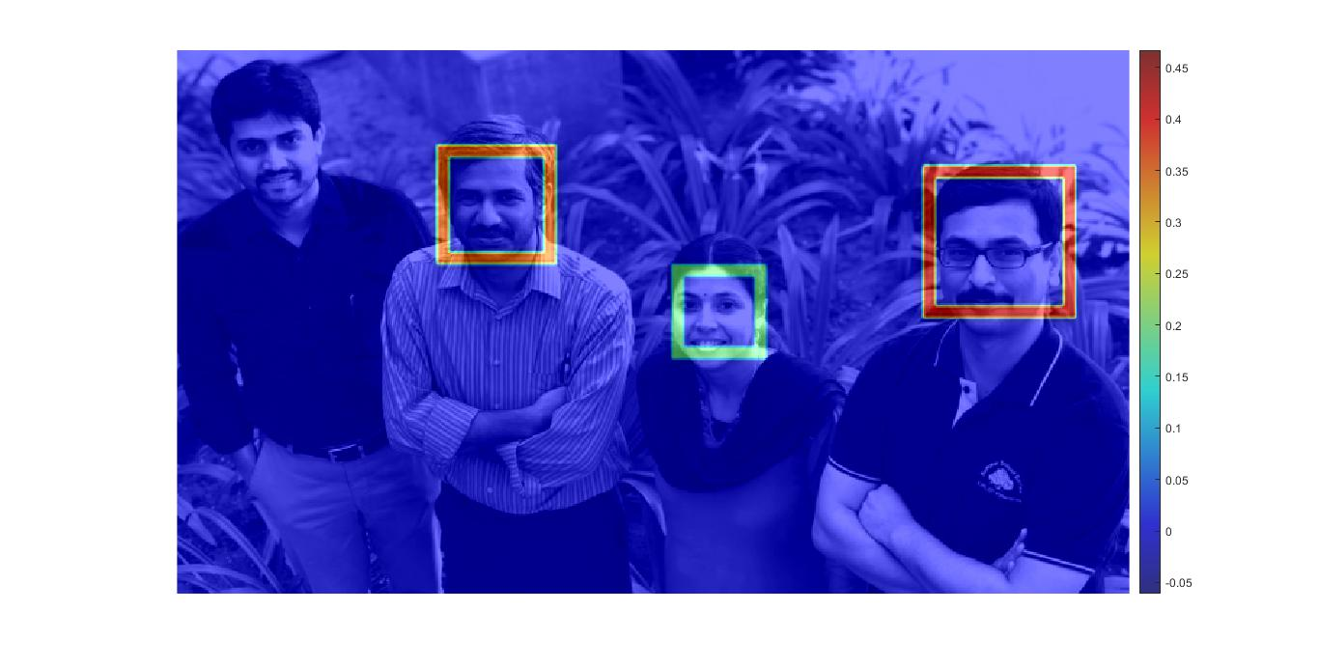
Overview of One Shot Detection Scheme
Query Output

Slide 7
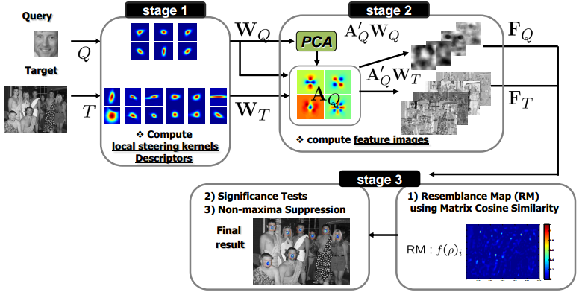
One Shot Detection System Pipeline

Slide 8
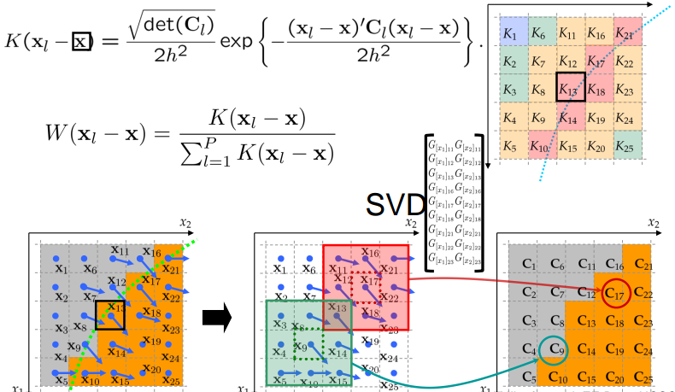
Stage 1: Calculation of Local Descriptors

Slide 9
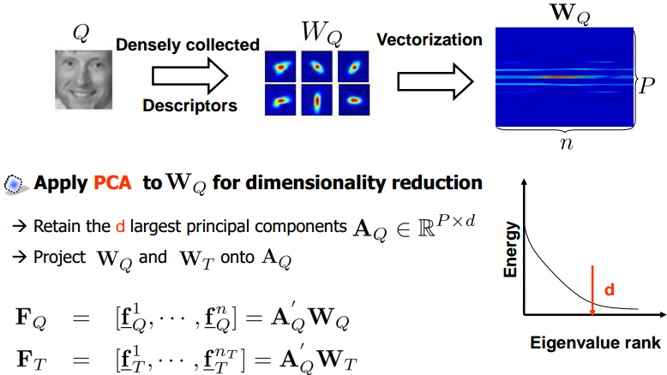
Stage 2: Feature Extraction from Descriptors

Slide 10
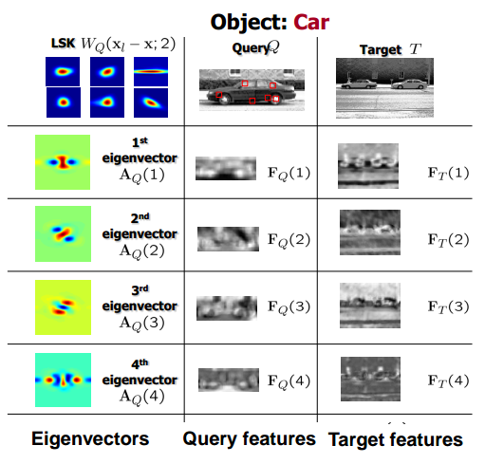
Stage 2: Salient features after PCA

Slide 11
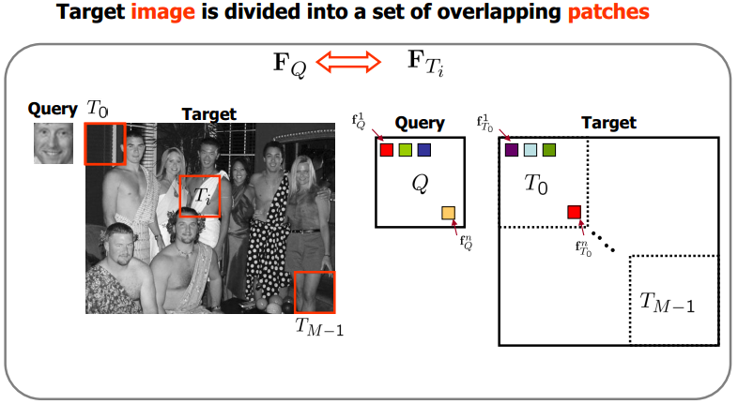
Stage 3: Finding similarity between features

Slide 12
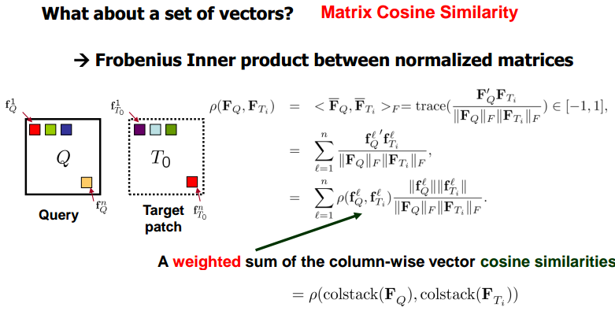
Stage 3: Matrix Cosine Similarity

Slide 13
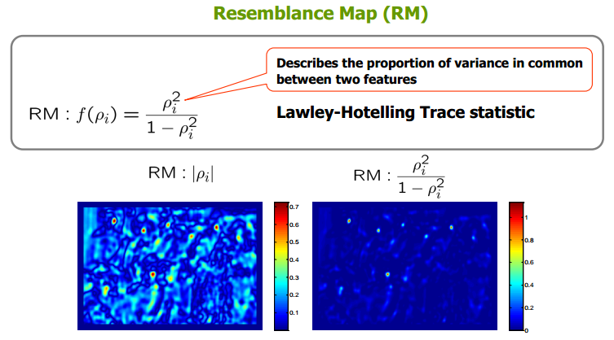
Stage 3: Generate Resemblance Map

Slide 14
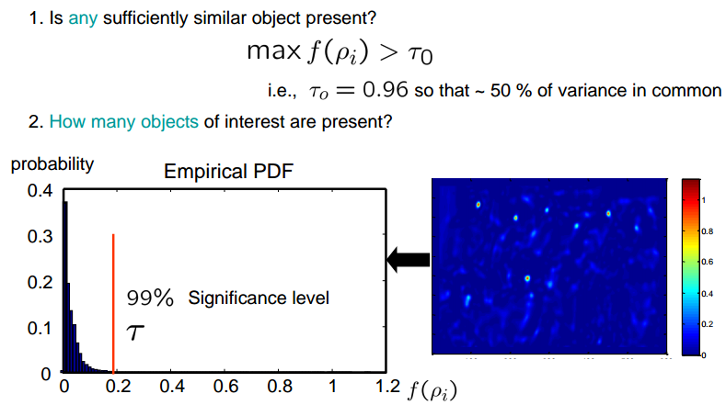
Stage 3: Significance Tests & Non Maxima Suppression

Slide 15
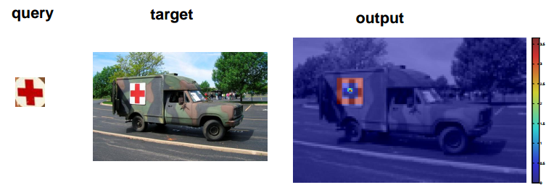
Experimental Results

Slide 16
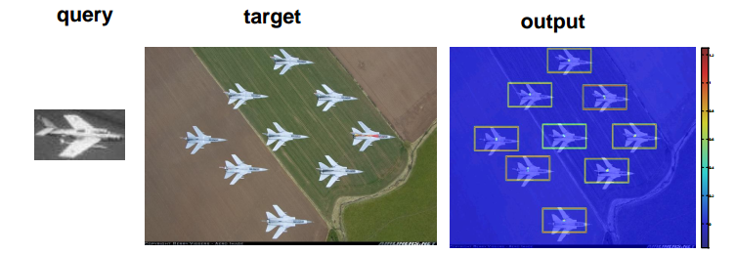
Experimental Results

Slide 17
Limitations & Future Work
Make algorithm scalable for image and (video) retrieval
Increase accuracy by incorporating “context”
Detect /recognize objects of interest in general degraded data without explicit restoration
Extension to large-scale data set requires a significant improvement of the computational complexity of the proposed method.

Slide 18
THANK YOU!

